Slide 1

Data Analyst
Diploma
Made By : Eng. Mohamed Saad

Slide 2




Introduction
Who I’m ?:
Business Reporting Analyst
at Vodafone Business
Data Analytics Engineer
at SustainGRC
Data Analyst Instructor
at Elharefa
Power Bi Developer
at ADROTECH

Slide 3
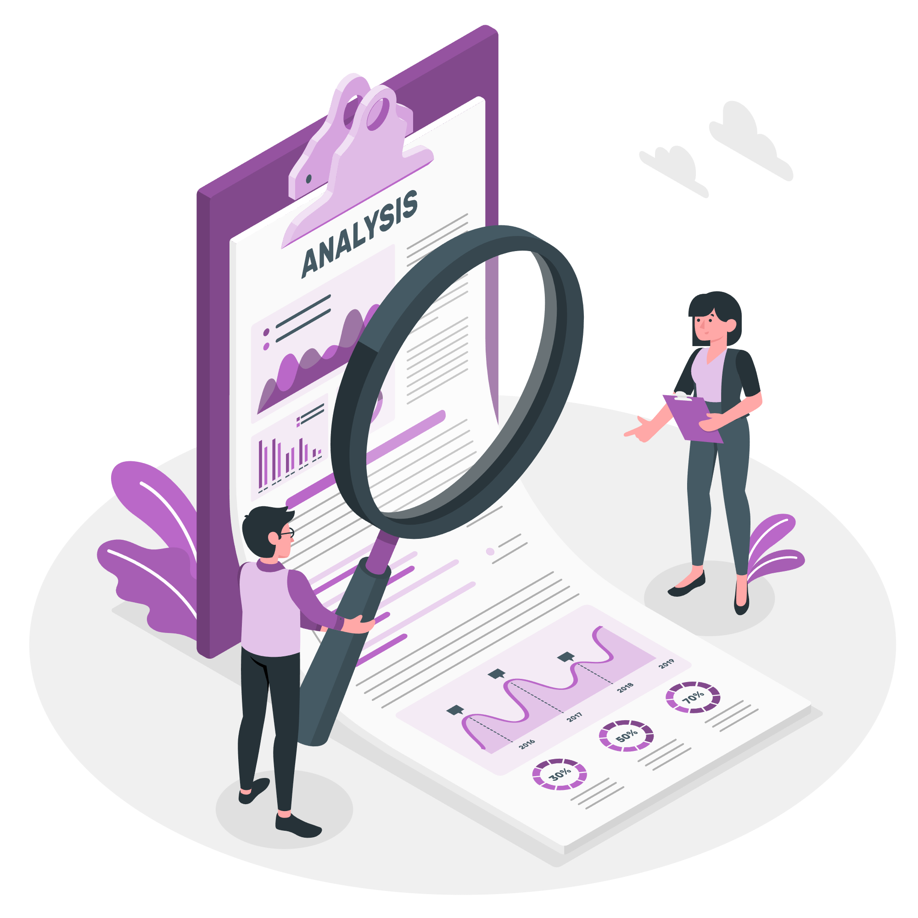
Introduction
Who Is Data analyst ?
is the person who collects data, cleans it, analyzes it, and turns it into clear insights that help people and companies make better decisions.
Types of Analysts ?
Data Analyst
Business Analyst
BI Analyst
Product Analyst
Marketing Analyst
Operations Analyst
Data Scientist
Data analytics Engineer

Slide 4
Data Analyst Track
01
02
03
04
05
Master Excel
Data Visualization Tools
Databases
05
Python
for Data Analysis
Data Warehouse & ETL Pipelines
Communication & Presentation Skills

Slide 5

Session1
Excel for Data Analyst

Slide 6
Session 1 : Excel
Data Sources:
Excel files with extensions : xlsx , xlsm , csv
Text Files , Json Files , Folder
Databases : Like SQL Server , MySQL, Postgres SQL , Oracle SQL
Clouds : Azure Cloud , Microsoft Fabric (Lakehouse , DW , DataFlow)
APIs or Web Links
Online Services : Share point , OneDrive , Others

Slide 7

Session 1 : Excel
Power Query Editor
Home Panel
Transform Panel
Add Column Panel
View Panel

Slide 8
Session 1 : Excel
How to Import Data :
Excel file : https://www.kaggle.com/datasets/jockeroika/ecommerce-data
API links : https://stooq.com/q/d/l/?s=aapl.us&i=d
Let’s Do Some Cleaning for Data

Slide 9
Session 1 : Excerise
Exercise 1 : Customer Orders Cleaning & Preparation
You work as a Data Analyst for an online store.
The sales team sends you raw customer orders data exported from different systems.
The file is messy and not ready for analysis. (Download Ex 1 file)
Your task is to use Power Query Editor to clean, transform, and prepare the data.

Slide 10
Session 1 : Exercise
Exercise 2 : credit Card Transactions Analysis
You are working as a Data Analyst in a Bank.
The bank stores data in separate systems, so customer, card, transaction, and fraud data are in different tables.
Load Data of ( Ex 2 ) !
Management wants a single, clean dataset to:
Understand customer spending
Identify fraud impact
Analyze transactions by customer segment
Your job is to combine and transform the data using Power Query.

Slide 11
Session 1 : Exercise
Exercise 3 : Cafe Sales Data Cleaning & Preparation
You are a Data Analyst working for a cafe chain.
Sales data is collected from different cashiers and systems, resulting in dirty and inconsistent data.
- Load dataset from (Ex 3) file
Management wants clean and reliable sales data to:
Analyze total revenue
Understand best-selling items
Compare payment methods and locations
Your task is to clean and prepare the data using Power Query Editor.

Slide 12

02
Excel Measures & Formats

Slide 13

Session 1 : Excel Format
Home Panel : Excel formats
Conditional Formatting
Formats of Numbers
Cell formats

Slide 14

Session 1 : Excel Format
Formula Panel : Excel Measures
Formula
Common measures : Mean , median ,sum..
Keywords

Slide 15
Session 1 : Exercise
Exercise 4 : Europe Sales Performance Analysis
You are a Junior Data Analyst in a European retail company.
The company sells different products across European countries using online and offline channels.
- Load Dataset (Ex4) File !
Management wants a simple performance report to understand:
Countries that have Top Profits
Number of orders per each Channel
Top Items & Countries by Revenue !
Please give me Small and simple Report with good conditional Format to represent the above KPIs in Tables or Text format (No Need for Charts) !!!!

Slide 16
Session 1 : Exercise
Exercise 5 : Amazon Sales
You are a Junior Data Analyst in a Amazon company.
- Load Dataset (Ex5) File !
Management wants a simple performance report to understand:
Products his price bigger than 1000
Products with rate bigger than 4.0
How many Products we have now where his price lower than 100 ?
Please give me Small and simple Report with good conditional Format to represent the above KPIs in Tables or Text format (No Need for Charts) !!!!

Slide 17
Thanks
Do you have any questions?

